Slide 1



SUBJECT:
Advanced Java Programming
TOPIC:
Java Server Pages
J S P
This work is licensed under a Creative Commons Attribution-NonCommercial-ShareAlike 4.0 International License. You are free to use, distribute and modify it, for noncommercial purposes only, provided you acknowledge the source.

Slide 2
Outline
Introduction
Comparison with Servlets
JSP Vs Servlets
First JSP Program
JSP Architecture
Life Cycle of JSP
JSP Scripting Elements
JSP Directives
JSP Action tags
JSP Implicit Objects
Expression Language
JSP Standard Tag Libraries
JSTL Tags
Core
Function
SQL
JSP XML Tag
Custom Tag
Session Management
Cookies handling
Exception Handling
JSP application design with MVC
Advantages of MVC Design
Form processing
Database access

Slide 3
INTRODUCTION

Slide 4
Introduction
JSP Stands for Java Server Pages.
A JSP page consists of HTML tags and JSP tags.
The JSP pages are easier to maintain than servlet because we can separate designing and development logic.
JSP is a server side scripting language.

Slide 5
COMPARISON WITH SERVLETS

Slide 6
Problems with Servlet
Inside the one and only one class in servlet alone, we will perform various task:
Acceptance of request
Process the request
Handling the business logic
Generation of response
For creating a servlet knowledge of java and html both is needed.
While developing an app if the look and feel of prog. changes we have to change the entire servlet class.

Slide 7
JSP Vs Servlets
Sr. No. | JSP | SERVLET
1 | JSP is a scripting lang which generates dynamic content | Servlet are java prog. that can be compiled to generate dynamic content
2 | JSP runs slower than servlet | Servlet runs faster than JSP
3 | In MVC JSP acts as view. | In MVC Servlet acts as controller.
4 | JSP can build custom tags | No facility for creating custom tags
5 | It is easier to code a JSP | The servlet are basically complex java prog

Slide 8
Prog: First JSP Program
Any text, HTML tags, or JSP elements you write must be outside the scriptlet. Following is the simple and first example for JSP:
<html>
<head><title>Hello World</title></head>
<body>
Hello World! <br/>
<%
out.println("Hello World!");
%>
</body>
</html>

Slide 9
JSP SCRIPTING ELEMENTS

Slide 10
JSP SCRIPTING ELEMENTS
Scriptlets
A scriptlet can contain any number of JAVA language statements, variable or method declarations, or expressions that are valid in the page scripting language.
Following is the syntax of Scriptlet:
<% code fragment %>
There are three types of scripting elements:
scriptlet tag
expression tag
declaration tag

Slide 11
Scriptlet Tag
In JSP, java code can be written inside the jsp page using the scriptlet tag.
Syntax:
<%
………………………………
……………………. ………….
%>

Slide 12
Scriptlet Tag Example
Example:
<html>
<head><title>Hello World</title></head>
<body>
Hello World!<br/>
<%
out.println("Your IP address is " +
request.getRemoteAddr());
%>
</body>
</html>

Slide 13
Prog: JSP scriptlet tag that prints the user name
File1: index.html
<html>
<body>
<form action="welcome.jsp">
<input type="text" name="uname">
<input type="submit" value="go"><br/>
</form>
</body>
</html>

Slide 14
Prog: JSP scriptlet tag that prints the user name
File2. welcome.jsp
<html>
<body>
<%
String name=request.getParameter("uname");
out.print("welcome "+name);
%>
</body>
</html>

Slide 15
JSP expression tag
The code placed within JSP expression tag is written to the output stream of the response.
Syntax of JSP expression tag:
<%= statement %>

Slide 16
JSP expression tag (Cont.)
A JSP expression element contains a scripting language expression that is evaluated, converted to a String, and inserted where the expression appears in the JSP file.
Because the value of an expression is converted to a String, you can use an expression within a line of text, whether or not it is tagged with HTML, in a JSP file.

Slide 17
Example 1 of JSP expression tag
In this example of jsp expression tag, we are simply displaying a welcome message.
<html>
<body>
<%= "welcome to jsp" %>
Today's date:
<%= ( new java.util.Date() ) %>
</body>
</html>

Slide 18
Example 2 of JSP expression tag that prints current time
<html>
<body>
Current Time:
<%=
java.util.Calendar.getInstance().getTime()
%>
</body>
</html>

Slide 19
Example 3 of JSP expression tag that prints the user name
File: index.jsp
<html>
<body>
<form action="welcome.jsp">
<input type="text" name="uname"><br/>
<input type="submit" value="go">
</form>
</body>
</html>

Slide 20
Example 3 of JSP expression tag that prints the user name
File: welcome.jsp
<html>
<body>
<%=
"Welcome "+request.getParameter("uname")
%>
</body>
</html>

Slide 21
JSP Declaration Tag
The JSP declaration tag is used to declare fields and methods.
Syntax of JSP declaration tag
The syntax of the declaration tag is as follows:
<%! field or method declaration %>
Following is the simple example for JSP Declarations:
<%! int i = 0; %>
<%! int a, b, c; %>
<%! Circle a = new Circle(2.0); %>

Slide 22
Example 1 of JSP declaration tag that declares field
File: index.jsp
<html>
<body>
<%! int data=50; %>
<%= "Value of the variable is:"+data %>
</body>
</html>

Slide 23
Example 2 of JSP declaration tag that declares method
File: index.jsp
<html>
<body>
<%!
int cube(int n){
return n*n*n;
}
%>
<%= "Cube of 3 is:"+cube(3) %>
</body>
</html>

Slide 24
SIMPLE FORM PROCESSING
EXAMPLE

Slide 25
JSP FORM PROCESSING
Form is a very common way of interaction in web sites.
The <form> tag is used so that user can enter the form details.
The web-browser used two method to pass this data to business logic
The two methods are GET and POST.

Slide 26
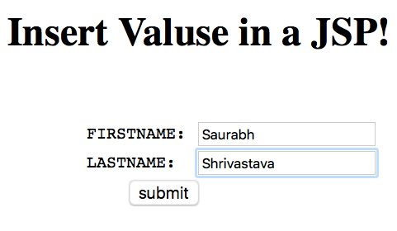

Prog: JSP Form Processing
index.jsp

Slide 27
Files needed to be created:
index.jsp
demojsp.jsp
web.xml

Slide 28
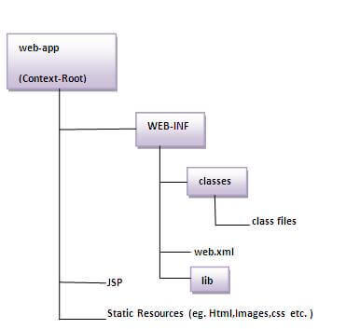
The Directory structure of JSP
The directory structure of JSP page is same as Servlet. We contain the JSP page outside the WEB-INF folder or in any directory.

Slide 29
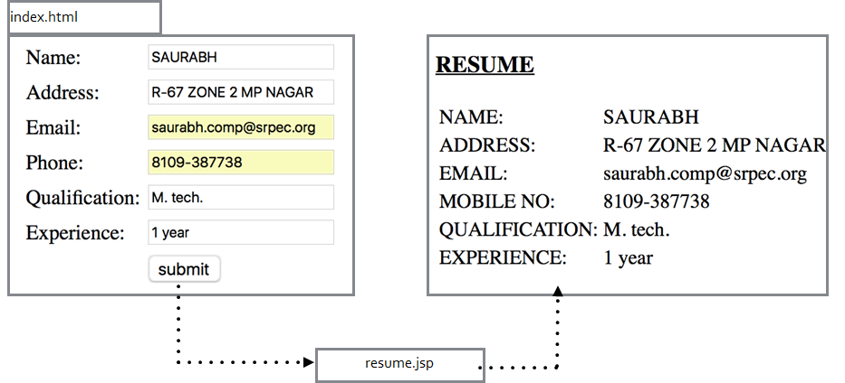
Files needed to be created:
File: index.html
<!DOCTYPE html>
<html> <body> <form action= "demojsp.jsp" method="GET">
FIRSTNAME: <input type="text" name="fname"/>
LASTNAME: <input type="text" name="lname"/>
<input type="submit" value="submit"/>
</form>
</body>
</html>
File: demo.jsp
<body>
FIRSTNAME: <%= request.getParameter("fname") %>
LASTNAME: <%= request.getParameter("lname") %>
</body>

Slide 30
Files needed to be created:
File: demojsp.jsp
<%@page contentType="text/html" pageEncoding="UTF-8"%>
<!DOCTYPE html>
<html>
<body>
FIRSTNAME: <%= request.getParameter("fname") %> <br>
LASTNAME: <%= request.getParameter("lname") %>
</body>
</html>

Slide 31
Files needed to be created:
File: web.xml
<?xml version="1.0" encoding="UTF-8"?>
<web-app >
<welcome-file-list>
<welcome-file>index.jsp</welcome-file>
</welcome-file-list>
</web-app>

Slide 32
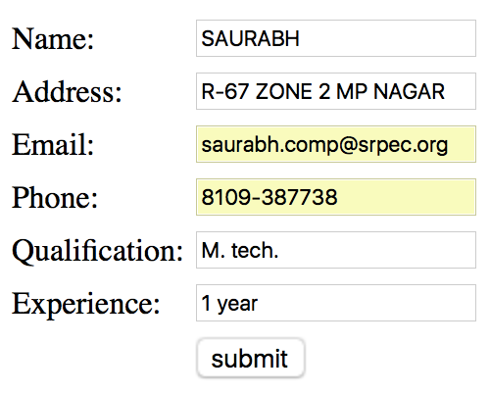
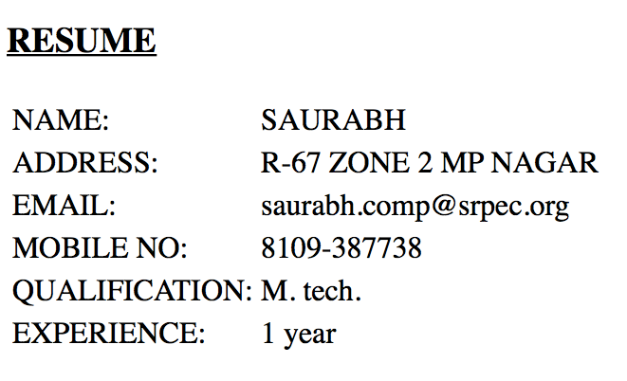
TASK: Write a prog that prints your details through a Form
index.html
resume.jsp

Slide 33
JSP ARCHITECTURE

Slide 34
JSP - Architecture
The web server needs a JSP engine ie. container to process JSP pages.
The JSP container is responsible for intercepting requests for JSP pages.
A JSP container works with the Web server to provide the runtime environment and other services a JSP needs. It knows how to understand the special elements that are part of JSPs.

Slide 35
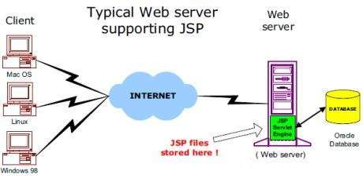
JSP – Architecture (Cont.)

Slide 36
JSP Processing
As with a normal page, your browser sends an HTTP request to the web server.
The web server recognizes that the HTTP request is for a JSP page and forwards it to a JSP engine. This is done by using the URL or JSP page which ends with .jsp instead of .html.
The JSP engine loads the JSP page from disk and converts it into a servlet content.

Slide 37
JSP Processing (Cont.)
This conversion is very simple in which all template text is converted to println( ) statements and all JSP elements are converted to Java code that implements the corresponding dynamic behavior of the page.
The JSP engine compiles the servlet into an executable class and forwards the original request to a servlet engine.
A part of the web server called the servlet engine loads the Servlet class and executes it. During execution, the servlet produces an output in HTML format, which the servlet engine passes to the web server inside an HTTP response.

Slide 38
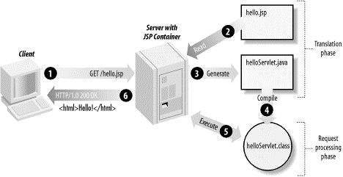
JSP Processing (Cont.)
The web server forwards the HTTP response to your browser in terms of static HTML content.
Finally web browser handles the dynamically generated HTML page inside the HTTP response exactly as if it were a static page.

Slide 39
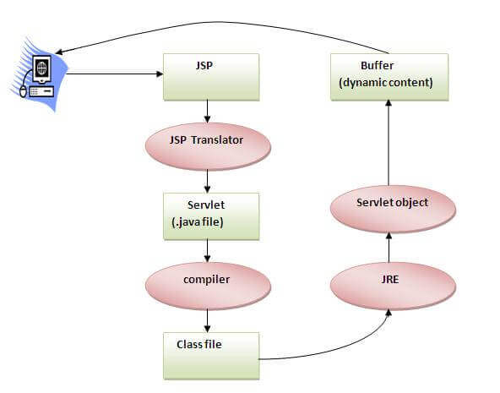
LIFE CYCLE OF JSP (cont.)

Slide 40
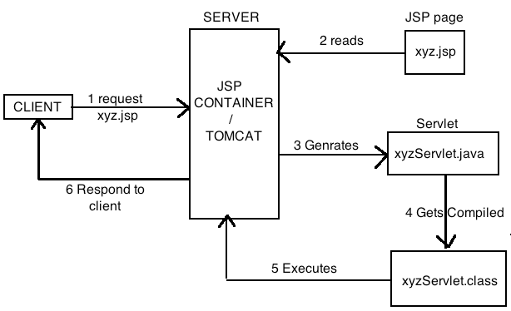
LIFE CYCLE OF JSP
Client makes a request for required JSP page to the server.
The server must have a JPS container to process the request.
For the request the JSP container searches the request and reads the desired JSP page.

Slide 41
LIFE CYCLE OF JSP (cont.)
Then this JSP page is converted into corresponding servlet. This phase is also called as translation phase. The output of a translation phase is a Servlet.
The Servlet is then compiled to generate the servlet class file. Using this class file response is generate. This phase is called as request processing phase.
The JSP container will execute the servlet class.
A response page is return to the client

Slide 42
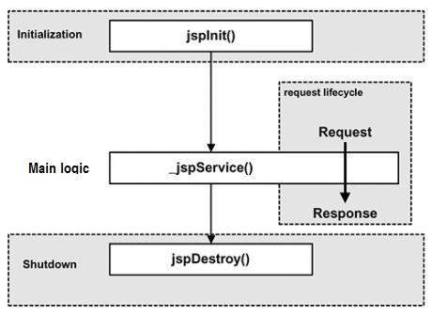
LIFE CYCLE OF JSP (cont.)
The following are the paths followed by a JSP
Compilation
Initialization
Execution
Cleanup

Slide 43
LIFE CYCLE OF JSP (cont.)
JSP Compilation:
When a browser asks for a JSP, the JSP engine first checks to see whether it needs to compile the page.
If the page has never been compiled, or if the JSP has been modified since it was last compiled, the JSP engine compiles the page.

Slide 44
LIFE CYCLE OF JSP (cont.)
The compilation process involves three steps:
Parsing the JSP.
Turning the JSP into a servlet.
Compiling the servlet.

Slide 45
LIFE CYCLE OF JSP (cont.)
JSP Initialization:
When a container loads a JSP it invokes the jspInit() method before servicing any requests. If you need to perform JSP-specific initialization, override the jspInit() method:
public void jspInit(){
// Initialization code...}
Typically initialization is performed only once and as with the servlet init method, you generally initialize database connections, open files, and create lookup tables in the jspInit method.

Slide 46
LIFE CYCLE OF JSP (cont.)
JSP Execution:
This phase of the JSP life cycle represents all interactions with requests until the JSP is destroyed.
Whenever a browser requests a JSP and the page has been loaded and initialized, the JSP engine invokes the _jspService() method in the JSP.
The _jspService() method takes an HttpServletRequest and an HttpServletResponse as its parameters as follows:
void _jspService(HttpServletRequest request, HttpServletResponse response)
{ // Service handling code...}

Slide 47
LIFE CYCLE OF JSP (cont.)
JSP Cleanup:
The destruction phase of the JSP life cycle represents when a JSP is being removed from use by a container.
The jspDestroy() method is the JSP equivalent of the destroy method for servlets. Override jspDestroy when you need to perform any cleanup, such as releasing database connections or closing open files.
public void jspDestroy()
{ // Your cleanup code goes here. }

Slide 48
JSP IMPLICIT OBJECTS

Slide 49
JSP Implicit Objects
There are 9 jsp implicit objects. These objects are created by the web container that are available to all the jsp pages.
The available implicit objects are out, request, config, session, application etc.
The implicit objects are pre-defined variable used to access request and application data.
A list of the 9 implicit objects is given in next slide.

Slide 50
JSP Implicit Objects (Cont.)
Object | Class/Interface | Meaning
out | JspWriter | It provides method related to I/O
request | HttpServletRequest | It provides method for accessing information made by current request
response | HttpServletResponse | It provides method for sending information
config | ServletConfig | For creating config object
application | ServletContext | For creating context object
session | HttpSession | This variable is used for accessing current client session
exception | Throwable | Used for handling Errors
page | Object | Used for handling page as an object
pageContext | PageContext | To access attributes from one of the four scopes.

Slide 51
JSP Implicit Object – out
For writing any data to the buffer, JSP provides an implicit object named out. It is the object of JspWriter. In case of servlet you need to write:
PrintWriter out=response.getWriter();
Example:
<html>
<body>
<% out.print("Today is:"+ new java.util.Date()); %>
</body>
</html>

Slide 52
JSP Implicit Object - request
JSP request is an implicit object of type HttpServletRequest i.e. created for each jsp request by the web container.
It can be used to get request information such as parameter, header information, remote address, server name, server port, content type, character encoding etc.
It can also be used to set, get and remove attributes from the jsp request scope.

Slide 53
JSP Implicit Object – request – Example
index.html
<form action="welcome.jsp">
<input type="text" name="uname"> <br/>
<input type="submit" value="go">
</form>
welcome.jsp
<%
String name=request.getParameter("uname");
out.print("welcome "+name);
%>

Slide 54
JSP Implicit Object – response
JSP response is an implicit object of type HttpServletResponse. The instance of HttpServletResponse is created by the web container for each jsp request.
It can be used to add or manipulate response such as redirect response to another resource, send error etc.

Slide 55
JSP Implicit Object – response – Example
index.html
<form action="welcome.jsp">
<input type="text" name="uname"> <br/>
<input type="submit" value="go">
</form>
welcome.jsp
<%
response.sendRedirect("http://www.google.com");
%>

Slide 56
JSP Implicit Object – config
JSP config is an implicit object of type ServletConfig.
This object can be used to get initialization parameter for a particular JSP page.
The config object is created by the web container for each jsp page.
Generally, it is used to get initialization parameter from the web.xml file.
Example of config implicit object:
Three files required:
index.html
web.xml file
welcome.jsp

Slide 57
JSP Implicit Object – config – Example: index.html
<form action="welcome.jsp">
Name: <input type="text" name="uname">
<br/>
<input type="submit" value="go">
</form>

Slide 58
JSP Implicit Object – config – Example: web.xml
<web-app>
<servlet>
<servlet-name>Sample</servlet-name>
<jsp-file>/welcome.jsp</jsp-file>
<init-param>
<param-name>dname</param-name>
<param-value>sun.jdbc.odbc.JdbcOdbcDriver</param-value>
</init-param>
</servlet>
<servlet-mapping>
<servlet-name>Sample</servlet-name>
<url-pattern>/welcome</url-pattern>
</servlet-mapping>
</web-app>

Slide 59
JSP Implicit Object – config – Example: welcome.jsp
<%
out.print("Welcome "+request.getParameter("uname"));
String driver = config.getInitParameter("dname");
out.print("driver name is="+driver);
%>

Slide 60
JSP Implicit Object – application
JSP application is an implicit object of type ServletContext.
The instance of ServletContext is created only once by the web container when application or project is deployed on the server.
This object can be used to get initialization parameter from configuaration file (web.xml).
It can also be used to get, set or remove attribute from the application scope.
This initialization parameter can be used by all jsp pages.

Slide 61
JSP Implicit Object – application – Example: index.html
<form action="welcome">
Name: <input type="text" name="uname">
<br/>
<input type="submit" value="go">
</form>

Slide 62
JSP Implicit Object – application – Example: web.xml
<web-app>
<servlet>
<servlet-name>Sample</servlet-name>
<jsp-file>/welcome.jsp</jsp-file>
</servlet>
<servlet-mapping>
<servlet-name>Sample</servlet-name>
<url-pattern>/welcome</url-pattern>
</servlet-mapping>
<context-param>
<param-name>dname</param-name>
<param-value>sun.jdbc.odbc.JdbcOdbcDriver</param-value>
</context-param>
</web-app>

Slide 63
JSP Implicit Object – application – Example: welcome.jsp
<%
out.print("Welcome "+request.getParameter("uname"));
String driver=application.getInitParameter("dname");
out.print("driver name is="+driver);
%>

Slide 64
JSP Implicit Object – session
JSP session is an implicit object of type HttpSession.
It can be uses to set, get or remove attribute or to get session information.
Example of session implicit object:
Three files required:
index.html
welcome.jsp
second.jsp

Slide 65
JSP Implicit Object – session – Example: index.html
<html>
<body>
<form action="welcome.jsp">
<input type="text" name="uname">
<input type="submit" value="go"><br/>
</form>
</body>
</html>

Slide 66
JSP Implicit Object – session – Example: welcome.jsp
<html>
<body>
<%
String name=request.getParameter("uname");
out.print("Welcome "+name);
session.setAttribute("user", name);
%>
<a href="second.jsp">Second JSP page</a>
</body>
</html>

Slide 67
JSP Implicit Object – session – Example: second.jsp
<html>
<body>
<%
String name = (String)session.getAttribute("user");
out.print("Hello "+name);
%>
</body>
</html>

Slide 68
JSP Implicit Object – page
JSP page is an implicit object of type Object class.
This object is assigned to the reference of auto generated servlet class. It is written as:
Object page=this;
For using this object it must be cast to Servlet type.
For example:
<% (HttpServlet)page.log("message"); %>
Since, it is of type Object it is less used because you can use this object directly in jsp.For example:
<% this.log("message"); %>

Slide 69
JSP Implicit Object – pageContext
JSP pageContext is an implicit object of type PageContext class.
The pageContext object can be used to set, get or remove attribute from one of the following scopes:
page
request
session
application
In JSP, page scope is the default scope.
Example of pageContext implicit object:
Three files required:
index.html
welcome.jsp
second.jsp

Slide 70
JSP Implicit Object – pageContext – Example: index.html
<html>
<body>
<form action="welcome.jsp">
<input type="text" name="uname">
<input type="submit" value="go"><br/>
</form>
</body>
</html>

Slide 71
JSP Implicit Object – pageContext – Example: welcome.jsp
<html>
<body>
<%
String name=request.getParameter("uname");
out.print("Welcome "+name);
pageContext.setAttribute("user", name,
PageContext.SESSION_SCOPE);
%>
<a href="second.jsp">Second JSP page</a>
</body>
</html>

Slide 72
JSP Implicit Object – pageContext – Example: second.jsp
<html>
<body>
<%
String name = (String)pageContext.getAttribute("user",
PageContext.SESSION_SCOPE);
out.print("Hello "+name);
%>
</body>
</html>

Slide 73
JSP Implicit Object – exception
JSP exception is an implicit object of type java.lang.Throwable class.
This object can be used to print the exception. But it can only be used in error pages.It is better to learn it after page directive.
Example:
error.jsp
<%@ page isErrorPage="true" %>
<html>
<body>
Sorry following exception occured: <%= exception %>
</body>
</html>

Slide 74
JSP DIRECTIVES

Slide 75
JSP Directives
The jsp directives are messages that tells the web container how to translate a JSP page into the corresponding servlet.
There are three types of directives:
page directive
include directive
taglib directive
Syntax of JSP Directive
<%@ directive attribute="value" %>

Slide 76
JSP Directives (Cont.)
There are three types of directive tag
Directive | Description
<%@ page ... %> | Defines page-dependent attributes, such as scripting language, error page, and buffering requirements.
<%@ include ... %> | Includes a file during the translation phase.
<%@ taglib ... %> | Declares a tag library, containing custom actions, used in the page

Slide 77
Page Directive
The page directive defines attributes that apply to an entire JSP page.
import
contentType
extends
info
buffer
isELIgnored
language
errorPage
isErrorPage
IsThreadSafe

Slide 78
Page Directive 1: import
The import attribute is used to import class, interface or all the members of a package. It is similar to import keyword in java class or interface.
importTag.jsp
<html>
<body>
<%@ page import="java.util.Date" %>
Today is: <%= new Date() %>
</body>
</html>

Slide 79
Page Directive 2: contentType
The contentType attribute defines the MIME type of the HTTP response.
The default value is “text/html”.
<html>
<body>
<%@ page contentType="text/html" %>
</body>
</html>

Slide 80
Page Directive 3: Buffer
The buffer attribute sets the buffer size in kilobytes to handle output generated by the JSP page.
The default size of the buffer is 8Kb.
<html>
<body>
<%@ page buffer="16kb" %>
Today is: <%= new java.util.Date() %>
</body>
</html>

Slide 81
Prog: Use of import, contentType and buffer Page Directives
<%@page contentType="text/html" pageEncoding="UTF-8"%>
<!DOCTYPE html>
<html>
<head>
<title>Import,contentType and
buffer tag Example</title>
</head>
<body>
<%@page buffer="16kb" %>
<%@page import="java.util.Date" %>
Today is: <%= new Date() %>
</body>
</html>

Slide 82
Page Directive 4: isThreadSafe
Servlet and JSP both supports multithreaded.
If you want to control this behaviour of JSP page, you can use isThreadSafe attribute of page directive.
The value of isThreadSafe value is true.
If you make it false, the web container will serialise the multiple requests, i.e. it will wait until the JSP finishes responding to a request before passing another request to it.
Its syntax is:
<%@ page isThreadSafe="false" %>

Slide 83
Page Directive 5: info
This attribute simply sets the information of the JSP page.
<html>
<body>
<%@ page info="Made in India" %>
Manufacture: <%= this.getServletInfo() %>
</body>
</html>

Slide 84
Page Directive 6: errorPage
The errorPage attribute is used to define the error page, if exception occurs in the current page, it will be redirected to the error page.
index.jsp
<html>
<body>
<%@ page errorPage="myerrorpage.jsp" %>
<%= 100/0 %>
</body>
</html>

Slide 85
Page Directive 7: isErrorPage
The isErrorPage attribute is used to declare that the current page is the error page.
myerrorpage.jsp
<html>
<body>
<%@ page isErrorPage="true" %>
Sorry an exception occured!<br/>
The exception is: <%= exception %>
</body>
</html>

Slide 86
Page Directive 8: isELIgnored
We can ignore the Expression Language (EL) in jsp by the isELIgnored attribute.
By default its value is false i.e. Expression Language is enabled by default.
Syntax:
<%@ page isELIgnored="true" %>//Now EL will be ignored

Slide 87
Page Directive 9: language
The language attribute specifies the scripting language used in the JSP page. The default value is "java".

Slide 88
Page Directive 10: extends
The extends attribute defines the parent class that will be inherited by the generated servlet. It is rarely used.

Slide 89
JSP Include Directive
The include directive is used to include the contents of any resource it may be jsp file, html file or text file.
Syntax of include directive
<%@ include file="resourceName" %>

Slide 90
Prog: JSP Include Directive
In this example, we are including the content of the index.html file in a include_action.jsp page
<html>
<body>
<%@ include file="index.html" %>
</body>
</html>

Slide 91
JSP Taglib directive
The JavaServer Pages API allows you to define custom JSP tags that look like HTML or XML tags and a tag library is a set of user-defined tags that implement custom behavior.
The custom tags are those that are created by user.
The taglib directive declares that your JSP page uses a set of custom tags, identifies the location of the library, and provides a means for identifying the custom tags in your JSP page.
The taglib directive follows the following syntax:
Syntax JSP Taglib directive:
<%@ taglib uri="uriofthetaglibrary"
prefix="prefixoftaglibrary" %>

Slide 92
JSP Taglib directive (Cont.)
Where the uri attribute value resolves to a location the container understands and the prefix attribute informs a container what bits of markup are custom actions.
You can write XML equivalent of the above syntax as follows:
<jsp:directive.taglib uri="uri" prefix="prefixOfTag" />

Slide 93
JSP ACTION TAGS

Slide 94
JSP ACTION TAGs
The action tags are used to control the flow between pages and to use Java Bean.
The JSP action tags are given below:
JSP Action Tags | Description
jsp:forward | forwards the request and response to another resource.
jsp:include | includes another resource.
jsp:useBean | creates or locates bean object.
jsp:setProperty | sets the value of property in bean object.
jsp:getProperty | prints the value of property of the bean.
jsp:plugin | embeds another components such as applet.
jsp:param | sets the parameter value. It is used in forward and include mostly.

Slide 95
FORWARD ACTION AND PARAM TAG
The jsp:forward action tag is used to forward the request to another resource it may be jsp, html or another resource.
Syntax of jsp:forward action tag:
<jsp:forward page="relativeURL | <%= expression %>" />
Syntax of jsp:forward action tag with parameter:
<jsp:forward page="relativeURL | <%= expression %>">
<jsp:param name="parametername" value="parametervalue |
<%=expression%>" />
</jsp:forward>

Slide 96
Prog: Forward request to other page using forward action:
Files need to be created:
index.jsp
second.html

Slide 97
Prog: Forward request to other page using forward action
File: index.jsp
<%@page contentType="text/html" pageEncoding="UTF-8"%>
<!DOCTYPE html>
<html>
<body>
<h1>This page contains forward</h1>
<jsp:forward page="second.html"/>
<!-- Will forward request to the next page -->
</body>
</html>

Slide 98
Prog: Forward request to other page using forward action
File: second.html
<html>
<body>
<h1>You are in a forwarded page</h1>
</body>
</html>

Slide 99
jsp:include action tag
The jsp:include action tag is used to include the content of another resource it may be jsp, html or servlet.
The jsp include action tag includes the resource at request time so it is better for dynamic pages because there might be changes in future.
The jsp:include tag can be used to include static as well as dynamic pages.
Using the <jsp:include> action we can include different files in current jsp page.
Advantage of jsp:include action tag:
Code reusability : We can use a page many times such as including header and footer pages in all pages. So it saves a lot of time.

Slide 100
Prog: To include different types of files in a jsp page
File: index.html
<html>
<body>
<h3>This is a html page</h3>
</body>
</html>

Slide 101
Prog: To include different types of files in a jsp page
File: newjsp.jsp
<%@page contentType="text/html" pageEncoding="UTF-8"%>
<!DOCTYPE html>
<html>
<body>
<%--returns hour--%>
<br> Time is <%= new java.util.Date().getHours() %>
<%--returns min--%>
: <%= new java.util.Date().getMinutes()%>
<%--returns sec--%>
: <%= new java.util.Date().getSeconds()%>
</body>
</html>

Slide 102
Prog: To include different types of files in a jsp page
File: newjsp.jsp
<%@page contentType="text/html" pageEncoding="UTF-8"%>
<!DOCTYPE html>
<html>
<body>
<br> Date is <%= new java.util.Date() %>
</body>
</html>

Slide 103
Prog: To include different types of files in a jsp page
File: includejsp.jsp
<%@page contentType="text/html"
pageEncoding="UTF-8"%>
<!DOCTYPE html>
<html>
<body>
<h1>This page contains include action</h1>
<jsp:include page="index.html"/>
<jsp:include page="newjsp.jsp"/>
</body>
</html>

Slide 104
jsp:useBean action tag
The jsp:useBean action tag is used to locate or instantiate a bean class.
If bean object of the Bean class is already created, it doesn't create the bean depending on the scope.
But if object of bean is not created, it instantiates the bean.
Syntax of jsp:useBean action tag
<jsp:useBean id= "instanceName" scope= "page | request | session |
application" class= "packageName.className"
type= "packageName.className" beanName="packageName.className | <%= expression >" >
</jsp:useBean>

Slide 105
Syntax of jsp:useBean action tag
<jsp:useBean id= "instanceName" scope= "page | request | session | application" class= "packageName.className" " ></jsp:useBean>
id: is used to identify the bean in the specified scope.
scope: represents the scope of the bean. It may be page, request, session or application. The default scope is page.
page: specifies that you can use this bean within the JSP page. The default scope is page.
request: specifies that you can use this bean from any JSP page that processes the same request. It has wider scope than page.
session: specifies that you can use this bean from any JSP page in the same session whether processes the same request or not. It has wider scope than request.
application: specifies that you can use this bean from any JSP page in the same application. It has wider scope than session.
class: instantiates the specified bean class (i.e. creates an object of the bean class)

Slide 106
jsp:setProperty and jsp:getProperty action tags
The setProperty and getProperty action tags are used for developing web application with Java Bean.
In web development, bean class is mostly used because it is a reusable software component that represents data.
The jsp:setProperty action tag sets a property value or values in a bean using the setter method.
Syntax of jsp:setProperty action tag
<jsp:setProperty name="instanceOfBean" property= "*“
| property="propertyName" param="parameterName"
| property="propertyName" value="{ string |
<%= expression %>}" />

Slide 107
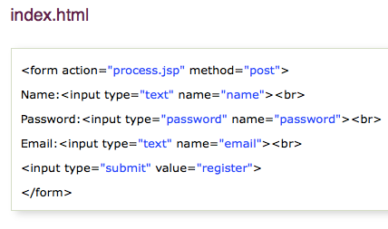
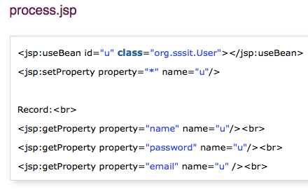
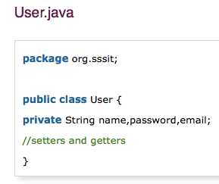
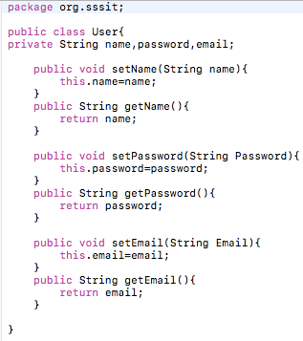

Slide 108
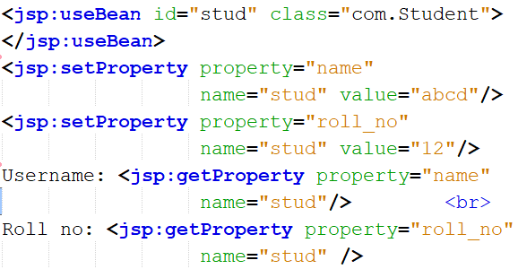
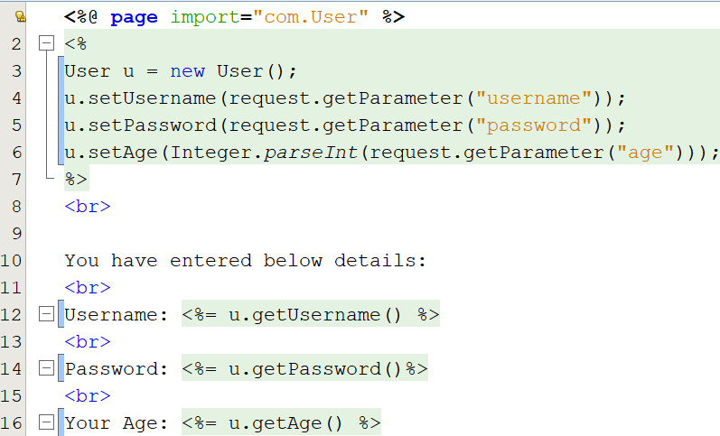

Slide 109
Expression Language (EL) in JSP

Slide 110
Expression Language (EL) in JSP
The Expression Language (EL) simplifies the accessibility of data stored in the Java Bean component, and other objects like request, session, application etc.
There are many implicit objects, operators and reserve words in EL.
Syntax for Expression Language (EL)
${ expression }

Slide 111
Expression Language (EL) in JSP (Cont.)
Variables
The web container evaluates a variable that appears in an expression by looking up its value according to the behavior of PageContext.findAttribute(String).
For example, when evaluating the expression ${product}, the container will look for product in the page, request, session, and application scopes and will return its value.
If product is not found, null is returned. A variable that matches one of the implicit objects described in Implicit Objects will return that implicit object instead of the variable's value.

Slide 112
Expression Language (EL) in JSP (Cont.)
Implicit Objects
The JSP expression language defines a set of implicit objects:
pageContext: The context for the JSP page. Provides access to various objects including:
servletContext: The context for the JSP page's servlet and any web components contained in the same application. See Accessing the Web Context.
session: The session object for the client. See Maintaining Client State.
request: The request the execution of the JSP page. See Getting Information from Requests.
response: The response returned by the JSP page. See Constructing Responses.

Slide 113
Expression Language (EL) in JSP (Cont.)
In addition, several implicit objects are available that allow easy access to the following objects:
param: Maps a request parameter name to a single value
paramValues: Maps a request parameter name to an array of values
header: Maps a request header name to a single value
headerValues: Maps a request header name to an array of values
cookie: Maps a cookie name to a single cookie
initParam: Maps a context initialization parameter name to a single value

Slide 114
Expression Language (EL) in JSP (Cont.)
Literals
The JSP expression language defines the following literals:
Boolean: true and false
Integer: as in Java
Floating point: as in Java
String: with single and double quotes; " is escaped as \", ' is escaped as \', and \ is escaped as \\.
Null: null

Slide 115
Expression Language (EL) in JSP (Cont.)
Operators
In addition to the . and [] operators discussed in Variables, the JSP expression language provides the following operators:
Arithmetic: +, - (binary), *, / and div, % and mod, - (unary)
Logical: and, &&, or, ||, not, !
Relational: ==, eq, !=, ne, <, lt, >, gt, <=, ge, >=, le. Comparisons can be made against other values, or against boolean, string, integer, or floating point literals.
Empty: The empty operator is a prefix operation that can be used to determine whether a value is null or empty.
Conditional: A ? B : C. Evaluate B or C, depending on the result of the evaluation of A.

Slide 116
Expression Language (EL) in JSP (Cont.)
Reserved Words
The following words are reserved for the JSP expression language and should not be used as identifiers.
and eq gt true instanceof
or ne le false empty
not lt ge null div mod

Slide 117
EL param example
In this example, we have created two files index.jsp and process.jsp.
The index.jsp file gets input from the user and sends the request to the process.jsp which in turn prints the name of the user using EL.
index.jsp
<form action="process.jsp">
Enter Name:<input type="text" name="name" /><br/><br/>
<input type="submit" value="go"/>
</form>
process.jsp
Welcome, ${ param.name }

Slide 118
EL sessionScope example
In this example, we printing the data stored in the session scope using EL. For this purpose, we have used sessionScope object.
index.jsp
<h3>welcome to index page</h3>
<%
session.setAttribute(“user”,”Jacob”);
%>
<a href="process.jsp">visit</a>
process.jsp
Value is ${ sessionScope.user }

Slide 119
EL cookie example
index.jsp
<h1>First JSP</h1>
<%
Cookie ck=new Cookie(“name”,”Jacob”);
response.addCookie(ck);
%>
<a href="process.jsp">click</a>
process.jsp
Hello, ${cookie.name.value}

Slide 120
JSP
STANDARD TAG LIBRARIES
(JSTL)

Slide 121
JSP - Standard Tag Library (JSTL)
The JavaServer Pages Standard Tag Library (JSTL) is a collection of useful JSP tags which encapsulates core functionality common to many JSP applications.
JSTL has support for common, structural tasks such as iteration and conditionals, tags for manipulating XML documents, internationalization tags, and SQL tags.
It also provides a framework for integrating existing custom tags with JSTL tags.

Slide 122
JSP STANDARD TAG LIBRARIES (JSTL)
The JSP Standard Tag Library (JSTL) represents a set of tags to simplify the JSP development.
Advantage of JSTL:
Fast Developement: JSTL provides many tags that simplifies the JSP.
Code Reusability: We can use the JSTL tags in various pages.
No need to use scriptlet tag: It avoids the use of scriptlet tag.
The JSTL tags can be classified, according to their functions, into following JSTL tag library groups that can be used when creating a JSP page:
Core Tags, Formatting tags, Function tags
SQL tags, XML tags

Slide 123
JSTL Tags:
Tag Name | Description
Core tags | The JSTL core tag provide variable support, URL management, flow control etc. The prefix of core tag is c.
Function tags | The functions tags provide support for string related function. The prefix is fn.
SQL tags | The JSTL sql tags provide SQL support. The prefix is sql.

Slide 124
CORE TAG:
The JSTL core tag provides variable support, URL management, flow control etc. The syntax used for including JSTL core library in your JSP is:
<%@ taglib uri="http://java.sun.com/jsp/jstl/core" prefix="c" %>

Slide 125
Tags | Description
c:out | It display the result of an expression, similar to the way <%=...%> tag work.
c:import | It Retrives relative or an absolute URL and display the contents.
c:set | It sets the result of an expression under evaluation in a 'scope' variable.
c:remove | It is used for removing the specified scoped variable from a particular scope.
c:catch | It is used for Catches any Throwable exceptions that occurs in the body.
c:if | It is conditional tag used for testing the condition and display the body content only if the expression evaluates is true.
c:choose, c:when, c:otherwise | It is the simple conditional tag that includes its body content if the evaluated condition is true.
c:forEach | It is the basic iteration tag. It repeats the nested body content for fixed number of times or over collection.
c:forTokens | It iterates over tokens which is separated by the supplied delimeters.
c:param | It adds a parameter in a containing 'import' tag's URL.
c:redirect | It redirects the browser to a new URL and supports the context-relative URLs.

Slide 126
JSTL Core <c:out> Tag
The <c:out> tag is similar to JSP expression tag. It will display the result of an expression, similar to the way < %=...% > work.
<%@ taglib uri="http://java.sun.com/jsp/jstl/core" prefix="c" %>
<html>
<head>
<title>Tag Example</title>
</head>
<body>
<c:out value="${'Welcome to JSTL'}"/>
</body>
</html>

Slide 127
JSTL Core <c:set> Tag
It is used to set the result of an expression evaluated in a 'scope'. The <c:set> tag is helpful because it evaluates the expression and use the result to set a value of JavaBean.
<%@ taglib uri="http://java.sun.com/jsp/jstl/core" prefix="c" %>
<html>
<head>
<title>Core Tag Example</title>
</head>
<body>
<c:set var="Income" scope="session" value="${4000*4}"/>
<c:out value="${Income}"/>
</body>
</html>

Slide 128
JSTL Core <c:remove> Tag
It is used for removing the specified variable from a particular scope.
<%@ taglib uri="http://java.sun.com/jsp/jstl/core" prefix="c" %>
<html>
<head>
<title>Core Tag Example</title>
</head>
<body>
<c:set var="income" scope="session" value="${4000*4}"/>
<p>Before Remove Value is: <c:out value="${income}"/></p>
<c:remove var="income"/>
<p>After Remove Value is: <c:out value="${income}"/></p>
</body>
</html>

Slide 129
JSTL Core <c:if> Tag
The < c:if > tag is used for testing the condition and it display the body content, if the expression evaluated is true.
<%@ taglib uri="http://java.sun.com/jsp/jstl/core" prefix="c" %>
<html>
<head>
<title>Core Tag Example</title>
</head>
<body>
<c:set var="income" scope="session" value="${4000*4}"/>
<c:if test="${income > 8000}">
<p>My income is: <c:out value="${income}"/><p>
</c:if>
</body>
</html>

Slide 130
JSTL Core <c:catch> Tag
It is used for Catches any Throwable exceptions that occurs in the body and optionally exposes it. In general it is used for error handling and to deal more easily with the problem occur in program.
<%@ taglib uri="http://java.sun.com/jsp/jstl/core" prefix="c" %>
<html>
<head>
<title>Core Tag Example</title>
</head>
<body>
<c:catch var ="catchtheException">
<% int x = 2/0;%>
</c:catch>
<c:if test = "${catchtheException != null}">
<p>The type of exception is : ${catchtheException} </p>
</c:if>
</body>
</html>

Slide 131
JSTL Core <c:choose>, <c:when>, <c:otherwise> Tag
The <c:choose> tag is a conditional tag that establish a context for mutually exclusive conditional operations. It works like a Java switch statement in which we choose between a numbers of alternatives.
The <c:when > is subtag of <choose > that will include its body if the condition evaluated be 'true'.
The < c:otherwise > is also subtag of < choose > it follows & <when > tags and runs only if all the prior condition evaluated is 'false'.
The c:when and c:otherwise works like if-else statement. But it must be placed inside c:choose tag.

Slide 132
<%@ taglib uri="http://java.sun.com/jsp/jstl/core" prefix="c" %>
<html>
<head>
<title>Core Tag Example</title>
</head>
<body>
<c:set var="income" scope="session" value="${4000*4}"/>
<p>Your income is : <c:out value="${income}"/></p>
<c:choose>
<c:when test="${income <= 1000}">
Income is not good.
</c:when>
<c:when test="${income > 10000}">
Income is very good.
</c:when>
<c:otherwise>
Income is undetermined...
</c:otherwise>
</c:choose>
</body>
</html>

Slide 133
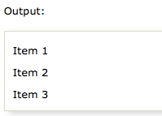
JSTL Core <c:forEach> Tag
The <c:for each > is an iteration tag used for repeating the nested body content for fixed number of times or over the collection.
<%@ taglib uri="http://java.sun.com/jsp/jstl/core" prefix="c" %>
<html>
<head>
<title>Core Tag Example</title>
</head>
<body>
<c:forEach var="j" begin="1" end="3">
Item <c:out value="${j}"/><p>
</c:forEach>
</body>
</html>

Slide 134
JSTL Core <c:redirect> Tag
The < c:redirect > tag redirects the browser to a new URL.
<%@ taglib uri="http://java.sun.com/jsp/jstl/core" prefix="c" %>
<html>
<head>
<title>Core Tag Example</title>
</head>
<body>
<c:set var="url" value="0" scope="request"/>
<c:if test="${url<1}">
<c:redirect url="http://javatpoint.com"/>
</c:if>
<c:if test="${url>1}">
<c:redirect url="http://facebook.com"/>
</c:if>
</body>
</html>

Slide 135
FUNCTION TAG LIBRARY
The JSTL function provides a number of standard functions, most of these functions are common string manipulation functions. The syntax used for including JSTL function library in your JSP is:
<%@ taglib uri="http://java.sun.com/jsp/jstl/functions" prefix="fn" %>

Slide 136
JSTL Functions | Description
fn:contains() | It is used to test if an input string containing the specified substring in a program.
fn:containsIgnoreCase() | It is used to test if an input string contains the specified substring as a case insensitive way.
fn:endsWith() | It is used to test if an input string ends with the specified suffix.
fn:indexOf() | It returns an index within a string of first occurrence of a specified substring.
fn:trim() | It removes the blank spaces from both the ends of a string.
fn:startsWith() | It is used for checking whether the given string is started with a particular string value.
fn:split() | It splits the string into an array of substrings.
fn:toLowerCase() | It converts all the characters of a string to lower case.
fn:toUpperCase() | It converts all the characters of a string to upper case.
fn:substring() | It returns the subset of a string according to the given start and end position.
fn:substringAfter() | It returns the subset of string after a specific substring.
fn:substringBefore() | It returns the subset of string before a specific substring.
fn:length() | It returns the number of characters inside a string, or the number of items in a collection.
fn:replace() | It replaces all the occurrence of a string with another string sequence.

Slide 137
Conversion of given string to lowercase
<%@ taglib uri="http://java.sun.com/jsp/jstl/core" prefix="c" %>
<%@ taglib uri="http://java.sun.com/jsp/jstl/functions" prefix="fn" %>
<html>
<head>
<title>Using JSTL Function </title>
</head>
<body>
<c:set var="str1" value=“I LOVE INDIA"/>
<c:set var="str2" value=“${fn:toLowerCase(str1)}”/>
<p><b>Original :</b>${str1}</p>
<p><b>Conversion :</b>${str2}</p>
</body>
</html>
OUT PUT:
Original : I LOVE INDIA
Conversion : i love india

Slide 138
SQL TAG LIBRARY
The JSTL sql tags provide SQL support. The url for the sql tags is http://java.sun.com/jsp/jstl/sql and prefix is sql.
<%@ taglib uri="http://java.sun.com/jsp/jstl/sql" prefix="sql" %>
SQL Tags | Descriptions
sql:setDataSource | It is used for creating a simple data source
sql:query | It is used for executing the SQL query defined in its sql attribute or the body.
sql:update | It is used for executing the SQL update defined in its sql attribute or in the tag body.

Slide 139
<%@ taglib uri="http://java.sun.com/jsp/jstl/core" prefix="c" %>
<%@ taglib uri="http://java.sun.com/jsp/jstl/sql" prefix="sql"%>
<html>
<head>
<title>sql:setDataSource Tag</title>
</head>
<body>
<sql:setDataSource var="db" driver="com.mysql.jdbc.Driver"
url="jdbc:mysql://localhost/test"
user="root" password="1234"/>
<sql:query dataSource="${db}" var="rs">
SELECT * from Students;
</sql:query>
<table border="2" width="100%">
<tr>
<th>Student ID</th>
<th>First Name</th>
<th>Last Name</th>
<th>Age</th>
</tr>

Slide 140
<c:forEach var="table" items="${rs.rows}">
<tr>
<td><c:out value="${table.id}"/></td>
<td><c:out value="${table.First_Name}"/></td>
<td><c:out value="${table.Last_Name}"/></td>
<td><c:out value="${table.Age}"/></td>
</tr>
</c:forEach>
</table>
</body>
</html>

Slide 141
FORMATTING TAG LIBRARY
Formatting tags:
The JSTL formatting tags are used to format and display text, the date, the time, and numbers for internationalized Web sites. Following is the syntax to include Formatting library in your JSP:
<%@ taglib prefix="fmt"
uri="http://java.sun.com/jsp/jstl/fmt" %>

Slide 142
FORMATTING TAG LIBRARY
Tag | Description
<fmt:formatNumber> | To render numerical value with specific precision or format.
<fmt:parseNumber> | Parses the string representation of a number, currency, or percentage.
<fmt:formatDate> | Formats a date and/or time using the supplied styles and pattern
<fmt:parseDate> | Parses the string representation of a date and/or time
<fmt:bundle> | Loads a resource bundle to be used by its tag body.
<fmt:setLocale> | Stores the given locale in the locale configuration variable.
<fmt:setBundle> | Loads a resource bundle and stores it in the named scoped variable or the bundle configuration variable.
<fmt:timeZone> | Specifies the time zone for any time formatting or parsing actions nested in its body.
<fmt:setTimeZone> | Stores the given time zone in the time zone configuration variable
<fmt:message> | To display an internationalized message.
<fmt:requestEncoding> | Sets the request character encoding

Slide 143
JSP XML tags
The XML tags are useful for creating and manipulating the XML documents through the JSP.
The url for the xml tags is http://java.sun.com/jsp/jstl/xml and prefix is x.
The syntax used for including JSTL XML tags library in your JSP is:
<%@ taglib uri="http://java.sun.com/jsp/jstl/xml" prefix="x" %>

Slide 144
XML Tags | Descriptions
x:out | Similar to <%= ... > tag.
x:parse | It is used for parse the XML data specified either in the tag body or an attribute.
x:set | It is used to sets a variable to the value of an XPath expression.
x:choose | It is a conditional tag that establish a context for mutually exclusive conditional operations.
x:when | It is a subtag of that will include its body if the condition evaluated be 'true'.
x:otherwise | It is subtag of that follows tags and runs only if all the prior conditions evaluated be 'false'.
x:if | It is used for evaluating the test XPath expression and if it is true, it will processes its body content.
x:transform | It is used in a XML document for providing the XSL(Extensible Stylesheet Language) transformation.
x:param | It is used along with the transform tag for setting the parameter in the XSLT style sheet.

Slide 145
JSTL CUSTOM TAGS

Slide 146
JSP Tag Extensions
Tag extensions or custom tags is a user-defined JSP language element. When a JSP page containing a custom tag is translated into a servlet, the tag is converted to operations on an object called a tag handler.
The Web container then invokes those operations when the JSP page's servlet is executed.
JSP tag extensions let you create new tags that you can insert directly into a JavaServer.

Slide 147
Create "Hello" Tag:
Consider you want to define a custom tag named <ex:Hello> and you want to use it in the following fashion without a body:
<ex:Hello />
The next code has simple coding where doTag() method takes the current JspContext object using getJspContext() method and uses it to send "Hello Custom Tag!" to the current JspWriter object.

Slide 148
Create "Hello" Tag (Cont.)
To create a custom JSP tag, you must first create a Java class that acts as a tag handler. So let us create HelloTag class as follows:
package com.tutorialspoint;
import javax.servlet.jsp.tagext.*;
import javax.servlet.jsp.*;
import java.io.*;
public class HelloTag extends SimpleTagSupport {
public void doTag() throws JspException, IOException {
JspWriter out = getJspContext().getOut();
out.println("Hello Custom Tag!");
}
}

Slide 149
Create "Hello" Tag (Cont.)
Now it's time to use above defined custom tag Hello in our JSP program as follows:
<%@ taglib prefix="ex" uri="WEB-INF/custom.tld"%>
<html>
<head>
<title>A sample custom tag</title>
</head>
<body>
<ex:Hello/>
</body>
</html>

Slide 150
Custom Tag Attributes:
:
Property | Purpose
name | The name element defines the name of an attribute. Each attribute name must be unique for a particular tag.
required | This specifies if this attribute is required or optional. It would be false for optional.
rtexprvalue | Declares if a runtime expression value for a tag attribute is valid
type | Defines the Java class-type of this attribute. By default it is assumed as String
description | Informational description can be provided.

Slide 151
Tag Handler API
The JSP API defines a set of classes and interfaces that you use to write custom tag handlers.
Your tag handler must be of one of the following two types:
Classic Tag Handlers implement one of three interfaces:
Tag
Implement the javax.servlet.jsp.tagext.Tag interface .The API also provides a convenience class TagSupport that implements the Tag interface and provides default empty methods for the methods defined in the interface.

Slide 152
Tag Handler API (Cont.)
2. BodyTag
Implement the javax.servlet.jsp.tagext.BodyTag interface if your custom tag needs to use a body. The API also provides a convenience class BodyTagSupport that implements the BodyTag interface and provides default empty methods for the methods defined in the interface.
3. IterationTag
Implement the javax.servlet.jsp.tagext.IterationTag interface to extend Tag by defining an additional method doAfterBody() that controls the reevaluation of the body.

Slide 153
Tag Handler API (Cont.)
Simple Tag Handlers (SimpleTag interface):
Implement the javax.servlet.jsp.tagext.SimpleTag interface if you wish to use a much simpler invocation protocol.
The SimpleTag interface does not extend the javax.servlet.jsp.tagext.Tag interface as does the BodyTag interface.
Therefore, instead of supporting the doStartTag() and doEndTag() methods, the SimpleTag interface provides a simple doTag() method, which is called once and only once for each tag invocation.

Slide 154
Tag Handler
A tag handler has access to an API that allows it to communicate with the JSP page.
The entry points to the API are two objects: the JSP context (javax.servlet.jsp.JspContext) for simple tag handlers and the page context (javax.servlet.jsp.PageContext) for classic tag handlers.
A tag handler can retrieve all the other implicit objects (request, session, and application) that are accessible from a JSP page through these objects.
In addition, implicit objects can have named attributes associated with them. Such attributes are accessed using [set|get]Attribute methods.

Slide 155
Tag Handler (Cont.)
Tag handler methods defined by the Tag and BodyTag interfaces are called by the JSP page’s servlet at various points during the evaluation of the tag.
To provide a tag handler implementation, you must implement the methods, summarized in Table that are invoked at various stages of processing the tag.

Slide 156
Tag Handler Methods
Tag Type | Interface | Methods
Basic | Tag | doStartTag, doEndTag
Attributes | Tag | doStartTag, doEndTag, setAttribute1,...,N, release
Body | Tag | doStartTag, doEndTag, release
Body, iterative evaluation | IterationTag | doStartTag, doAfterBody, doEndTag, release
Body, manipulation | BodyTag | doStartTag, doEndTag, release, doInitBody, doAfterBody

Slide 157
JspFragment
Encapsulates a portion of JSP code in an object that can be invoked as many times as needed.
The definition of the JSP fragment must only contain template text and JSP action elements. In other words, it must not contain scriptlets or scriptlet expressions.
At translation time, the container generates an implementation of the JspFragment abstract class capable of executing the defined fragment.

Slide 158
Tag files
A tag file is a source file that contains a fragment of JSP code that is reusable as a custom tag.
Tag files allow you to create custom tags using JSP syntax. Just as a JSP page gets translated into a servlet class and then compiled, a tag file gets translated into a tag handler and then compiled.
The recommended file extension for a tag file is .tag.

Slide 159
Tag File Directives
Directives are used to control aspects of tag file translation to a tag handler, and to specify aspects of the tag, attributes of the tag, and variables exposed by the tag.
Directive | Description
taglib | Identical to taglib for JSP pages.
include | Identical to include directive for JSP pages. Note that if the included file contains syntax unsuitable for tag files, a translation error will occur.
tag | Similar to the page directive in a JSP page, but applies to tag files instead of JSP pages. Also used for declaring custom tag properties such as display name
attribute | Declares an attribute of the custom tag defined in the tag file.
variable | Declares an EL variable exposed by the tag to the calling page.

Slide 160
JSP SESSION MANAGEMENT:
COOKIES

Slide 161
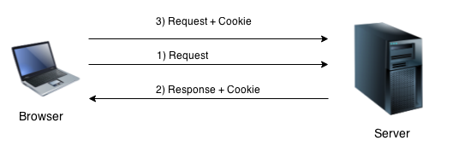
JSP COOKIES HANDLING
By default, each request is considered as a new request.
In cookies technique, we add cookie with response from the Server.
So cookie is stored in the cache of the browser.
After that if request is sent by the user, cookie is added with request by default.
Thus, we recognize the user as the old user.

Slide 162
JSP COOKIES HANDLING
Cookies are small text file that are stored in the client computer.
These are basically used to keep track of user who browse the web.
The info stored in the cookie are generally name, age , id, city and so on.
The servlet container sends a set of cookies to the web browser.
The browser stores the cookies on the local machine and makes use of this information next time when the browser is browsing the web.
Cookies are usually set in HTTP header.

Slide 163
JSP COOKIES HANDLING
Advantage of Cookies:
Simplest technique of maintaining the state.
Cookies are maintained at client side.
Disadvantage of Cookies:
It will not work if cookie is disabled from the browser.

Slide 164
Prog: Files needed to create, delete and read cookies
index.html
createcookie.jsp
readcookie.jsp
deletecookie.jsp

Slide 165
PROG: IMPLEMENTATION OF COOKIES IN JSP
index.html
<html>
<head>
<title>TODO supply a title</title>
</head>
<body>
<form action="createCookie.jsp" method="post">
USERNAME:<input type="text" name="name"><br>
CITY:<input type="text" name="city"><br>
<input type="submit" value="submit">
</form>
</body>
</html>

Slide 166
createCookie.jsp
<body>
<%
String name = request.getParameter("name");
String city = request.getParameter("city");
Cookie nameCookie = new Cookie("name", name);
Cookie cityCookie = new Cookie("city", city);
response.addCookie(nameCookie);
response.addCookie(cityCookie);
nameCookie.setMaxAge(60*60*24);
cityCookie.setMaxAge(60*60*24);
%>
<a href="readCookie.jsp" >Click here</a> to read the cookies
</body>
//creating cookie object
//creating cookie object
//adding cookie in the response
//adding cookie in the response
//changing the maximum age
//changing the maximum age

Slide 167
readCookie.jsp
<body>
<h3>Reading the cookie</h3>
<%
Cookie [] cookies = request.getCookies();
for(int i =0;i<cookies.length;i++){
out.println("Cookie_name"+cookies[i].getName()+"<br>");
out.println("Cookie_value"+cookies[i].getValue()+"<br>");
}
%>
<a href="deletecookies.jsp">Click here</a>To delete the cookie..!!
</body>
//return all the cookies from the browser
//printing name and value of cookie

Slide 168
deleteCookie.jsp
<body>
<%
Cookie nameCookie = new Cookie("name", "");
nameCookie.setMaxAge(0);
nameCookie.setValue("");
response.addCookie(nameCookie);
Cookie cityCookie = new Cookie("city", "");
cityCookie.setMaxAge(0);
cityCookie.setValue("");
response.addCookie(cityCookie);
%>
<a href="readCookie.jsp">Click here</a> to check the deletion..!!
</body>

Slide 169
EXCEPTION HANDLING

Slide 170
Exception Handling in JSP
The exception is normally an object that is thrown at runtime.
Exception Handling is the process to handle the runtime errors.
There may occur exception any time in your web application.
So handling exceptions is a safer side for the web developer.
In JSP, there are two ways to perform exception handling:
By errorPage and isErrorPage attributes of page directive
By <error-page> element in web.xml file

Slide 171
exception handling in jsp by the elements of page directive
In this case, you must define and create a page to handle the exceptions, as in the error.jsp page. The pages where may occur exception, define the errorPage attribute of page directive, as in the process.jsp page.
error.jsp
<%@ page isErrorPage="true" %>
<h3>Sorry an exception occured!</h3>
Exception is: <%= exception %>
process.jsp
<%@ page errorPage="error.jsp" %>
<% int i = 2/0; %>
<%= i %>

Slide 172
error-page element in web.xml file
This approach is better because you don't need to specify the errorPage attribute in each jsp page.
Specifying the single entry in the web.xml file will handle the exception. In this case, either specify exception-type or error-code with the location element.
If you want to handle all the exception, you will have to specify the java.lang.Exception in the exception-type element.

Slide 173
Cont.
<web-app>
<error-page>
<location>/error.jsp</location>
</error-page>
</web-app>

Slide 174
JSP DATABASE ACCESS:
CRUD APPLICATION

Slide 175
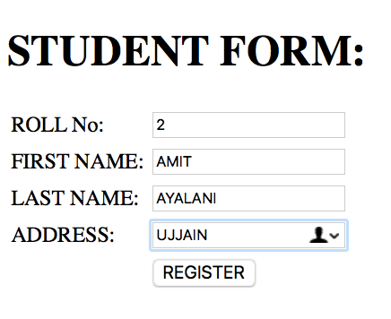

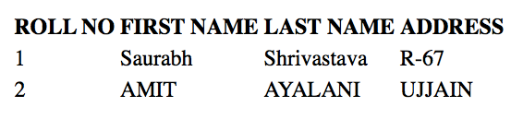
PROG: JSP DATABASE ACCESS
index.html
newjsp.jsp
……………
…………..
……………
………….
………..
………….
DATABASE
web browser

Slide 176
FILES NEED TO BE CREATED:
index.html
newjsp_1.jsp

Slide 177
index.html
<h1>STUDENT FORM:</h1>
<form action="newjsp_1.jsp" method="GET">
<table>
<tr>
<td>ROLL No:</td><td><input type="text" name="rollno" ></td>
</tr>
<tr>
<td>FIRST NAME:</td><td><input type="text" name="fname" ></td>
</tr>
<tr>
<td>LAST NAME:</td><td><input type="text" name="lname" ></td>
</tr>
<tr>
<td>ADDRESS:</td><td><input type="text" name="addr" ></td>
</tr>
<tr>
<td></td><td><input type="submit" value="REGISTER" ></td>
</tr>
</table>
</form>

Slide 178
newjsp_1.jsp
<%@page language="java" import="java.sql.*" %>
<%@page import="java.io.*" %>
<%@page contentType="text/html" pageEncoding=“UTF-8”%>
<html>
<body>
<table>
<tr>
<td><b>ROLL NO</b></td>
<td><b>FIRST NAME</b></td>
<td><b>LAST NAME</b></td>
<td><b>ADDRESS</b></td>
</tr>

Slide 179
<%
//read request parameter
String rollno = request.getParameter("rollno");
String fname = request.getParameter("fname");
String lname = request.getParameter("lname");
String addr = request.getParameter("addr");
//initialize variable of driver
String driverClassName="com.mysql.jdbc.Driver";
String url="jdbc:mysql://localhost:3306/ss";
String user="root";
String pwd="";
//register jdbc driver or load driver
Class.forName(driverClassName).newInstance();
//Open connection
Connection con=DriverManager.getConnection(url,user,pwd);
//making a prepared statement
PreparedStatement ps = con.prepareStatement("insert into formtb values(?,?,?,?)");
ps.setString(1, rollno);
ps.setString(2, fname);
ps.setString(3, lname);
ps.setString(4, addr);
int p = ps.executeUpdate();
PreparedStatement st = con.prepareStatement("select * from formtb");
ResultSet rs= st.executeQuery();
while(rs.next()){
%>

Slide 180
<tr>
<td><%= rs.getString("rollno") %></td>
<td><%= rs.getString("fname") %></td>
<td><%= rs.getString("lname") %></td>
<td><%= rs.getString("addr") %></td>
</tr>
<%
}
out.print("</table>");
rs.close();
ps.close();
st.close();
con.close();
%>
</table>
</body>
</html>

Slide 181
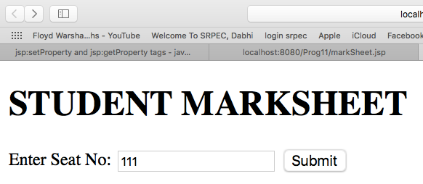
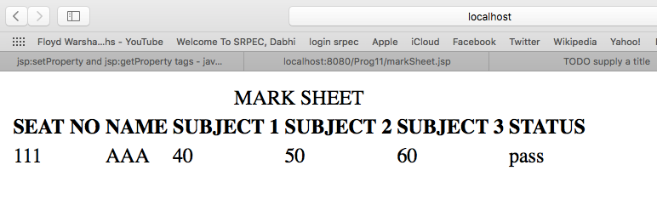
PROG: To display semester mark sheet

Slide 182
index.html
<html>
<head>
<title>TODO supply a title</title>
<meta charset="UTF-8">
<meta name="viewport" content="width=device-width, initial-scale=1.0">
</head>
<body>
<h1>STUDENT MARKSHEET</h1>
<form action="markSheet.jsp" method="post">
Enter Seat No: <input type="text" name="seatno">
<input type="submit" value="Submit">
</form>
</body>
</html>

Slide 183
markSheet.jsp
//register jdbc driver or load driver
Class.forName(driverClassName).newInstance();
//Open connection
Connection con=DriverManager.getConnection(url,user,pwd);
//making a prepared statement and storing in resultset
PreparedStatement st = con.prepareStatement("select * from MarkList where "
+ "SeatNo ="+seatno);
ResultSet rs= st.executeQuery();
while(rs.next()){
%>
//reading from result set
<tr>
<td><%= rs.getString("SeatNo") %></td>
<td><%= rs.getString("Name") %></td>
<td><%= rs.getString("Subject1") %></td>
<td><%= rs.getString("Subject2") %></td>
<td><%= rs.getString("Subject3") %></td>
<td><%= rs.getString("Status") %></td>
</tr>
<%
}
out.print("</table>");
rs.close();
st.close();
con.close();
%>
</table>
</body>
</html>
<%@page language="java" import="java.sql.*" %>
<%@page import="java.io.*" %>
<%@page contentType="text/html" pageEncoding="UTF-8"%>
<!DOCTYPE html>
<html>
<body>
<table>
<tr>
<td colspan="6"><center>MARK SHEET</center></td>
</tr>
<tr>
<td><b>SEAT NO</b></td>
<td><b>NAME</b></td>
<td><b>SUBJECT 1</b></td>
<td><b>SUBJECT 2</b></td>
<td><b>SUBJECT 3</b></td>
<td><b>STATUS</b></td>
</tr>
<%
//read request parameter
String seatno = request.getParameter("seatno");
//initialize variable of driver
String driverClassName="com.mysql.jdbc.Driver";
String url="jdbc:mysql://localhost:3306/marksheetDb";
String user="root";
String pwd="";

Slide 184
JSP APPLICATION DESIGN WITH MVC

Slide 185
JSP Application Design with MVC
JSP is a technology in which the request processing, business logic and presentation logic are separated out.
The design of JSP is called MVC Model.
MVC stands for Model-View-Controller.
The basic idea of MVC is to separate out the 3 logics of:
Modelling
Viewing
Controlling

Slide 186
MVC in JSP
MVC stands for Model View and Controller. It is a design pattern that separates the business logic, presentation logic and data.
Controller acts as an interface between View and Model. Controller intercepts all the incoming requests.
Model represents the state of the application i.e. data. It can also have business logic.
View represents the presentaion i.e. UI(User Interface).
we are using servlet as a controller, jsp as a view component, Java Bean class as a model.

Slide 187
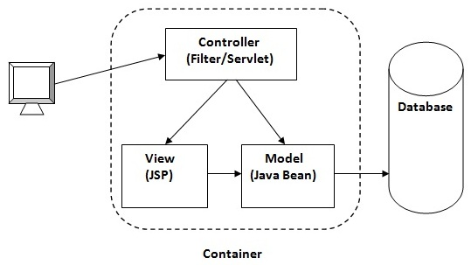
MVC in JSP (Cont.)

Slide 188
JSP Application Design with MVC
The business logic refers to the coding logic applied for manipulation of application data.
The presentation logic refers to the code written for look and feel of the web page.
The request processing / controlling is nothing but a combination of business logic and presentation logic. Request processing is done in order to generate response.

Slide 189
Advantages of MVC Design
MVC provides developer to keep separation between business logic, presentation and request processing.
Due to separation it is easy to change in presentation without disturbing the business logic.
Parallel development of code can be done.
The code can be reusable
It is easy to maintain and enhance the project using MVC architecture.

Slide 190
Advantages of MVC Design
One can attach multiple views to model in order to have different presentations.
The developer working on view model need not have to know about controller model and vice versa.

